Slide 1


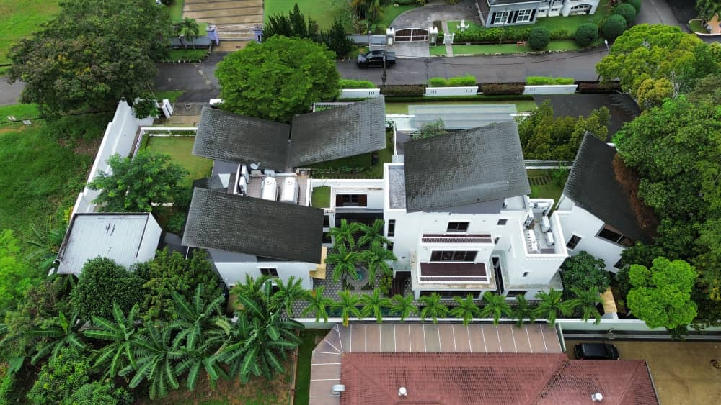



Alex Tan
No.123, Jalan 1/23, Taman Bahagia, KL
TNB Bill Before Solar
System Size
TNB Bill After Solar
RM1,500
16.32kWp
RM651
[Monthly Savings: ]
[ Panels]
RM849
32
This proposal follows Solar ATAP installation limits of 5kWac for 1-phase homes and 15kWac for 3-phase homes,
and can be adjusted to suit your requirements.

Slide 2






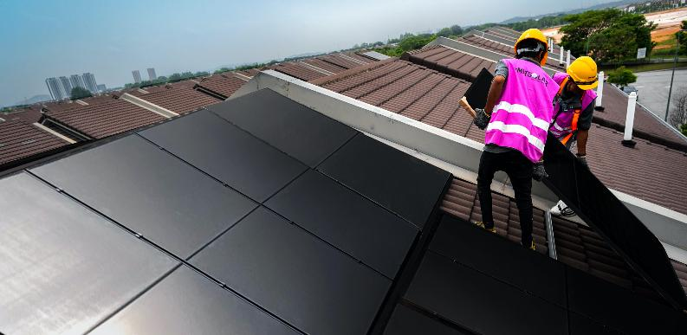
Why Emit Solar
Solar you can count on, from a brand you trust.
Solar Made Simple
Simple to Own
Low monthly payments, no credit card required.
Simple to Save
Real savings on your TNB bill from day one.
Simple to Maintain
Supported by brands you can trust.
Backed by Time
Proven Reliability
Decades of quality products, consistent performance and trusted service.
Complete Expertise
Every system designed, component handpicked and installer trained
to our highest standards.
Certified Safety
Fully licensed operations, highly skilled teams and strict safety standards.
www.emitsolar.com

Slide 3



16.32kWp
Solar System
Savings and system cost.
Number of Panels
Inverter Sizing
Solar Generation (+/-)
32
12kWac
1,673kWh
TNB Bill Estimates
 | Before Solar (+/-) RM | After Solar (+/-) RM
TNB Bill
Monthly Solar Savings | N/A | [ Savings]
10-Year Solar Savings | N/A | [Payback: ]
Savings are based on Solar Generation of (+/-) , assuming a Daytime Electricity Use of (+/-) . Additional savings may be achieved by switching to TNB’s Time of Use (ToU) Tariff.
Pricing & Purchase Options
 | Outright Purchase | Emit EzSolar
Total Amount Payable
Notes | Up to 60 months 0% interest credit card instalment plans with selected banks. | Payable monthly over 60 months. | Payable monthly over 120 months.
A deposit equivalent to RM1,000 (Outright Purchase) or 3 months’ payment (Emit EzSolar) is payable upon proposal acceptance for system reservation; offsets your balance payment or first 3 bills after installation.
RM1,500
RM651
RM849
57%
RM101,926
3.5 Years
1,016kWh
1,673kWh
RM35,600
RM593
RM371
(+/–) All figures are estimates and are based on current tariff and Solar ATAP policy.
TNB bill calculations use the general (non-ToU) tariff and exclude the Automatic Fuel Adjustment (AFA), which changes monthly and may be a charge or rebate.
www.emitsolar.com

Slide 4




TNB Bill Savings
How it’s achieved.
RM2,000
Home Electricity Usage (+/-)
Solar Generation
(+/-)
Daytime Electricity Use
(+/-)
Solar Export to TNB
(+/-)
1,048kWh
732kWh
262kWh
470kWh
[ of Home Usage]
25%
Electricity Consumption | Before Solar (+/-) kWh | After Solar (+/-) kWh
TNB Electricity Consumption
Daytime Electricity Use (powered by solar) | 0
Total Electricity Consumption
TNB Charges | Before Solar (+/-) RM | After Solar (+/-) RM
Energy
Capacity
Network
Automatic Fuel Adjustment
Energy Efficiency Incentive (EEI)
Retail
KWTBB
SST
Total Electricity Charges
Less Solar Export Credits [ ] | 0
EEI Adjustment | 0
Total TNB Bill
Solar Savings | Before Solar (+/-) RM | After Solar (+/-) RM
Savings from Daytime Electricity Use | 0
Savings from Solar Export to TNB | 0
Total Savings | 0
1048
786
262
1048
1048
283
212
48
36
135
101
0
0
0
-31
10
10
7
5
17
7
500
340
470kWh
-127
19
500
232
160
108
268
(+/–) All figures are estimates and are based on current tariff and Solar ATAP policy.
TNB bill calculations use the general (non-ToU) tariff and exclude the Automatic Fuel Adjustment (AFA), which changes monthly and may be a charge or rebate.
www.emitsolar.com

Slide 5
Purchase Options
Flexible payment terms to suit your need and budget.
Benefit | Outright Purchase | Emit EzSolar
Payment Options How you can pay for the system | Cash Credit card | Interest-free monthly payments
Credit Card Limit Utilisation Credit limit reduced by the full purchase amount | Yes | No
Installation Warranty Covers workmanship defects during installation | 1 year | 1 year
System Warranty Ensures the system works as installed | 2 years | 2 years
Extended Support Package Support for system faults caused by faulty components | Not Applicable | Up to 10 years [contract duration]
EV-Ready Energy Hub Quick setup with solar-first and dynamic load charging capability | Optional add-on | Optional add-on
Energy Storage System Store Solar Electricity for use at night | Optional add-on | Optional add-on
Energy Backup System Run essential appliances during blackouts | Optional add-on | Optional add-on
www.emitsolar.com

Slide 6
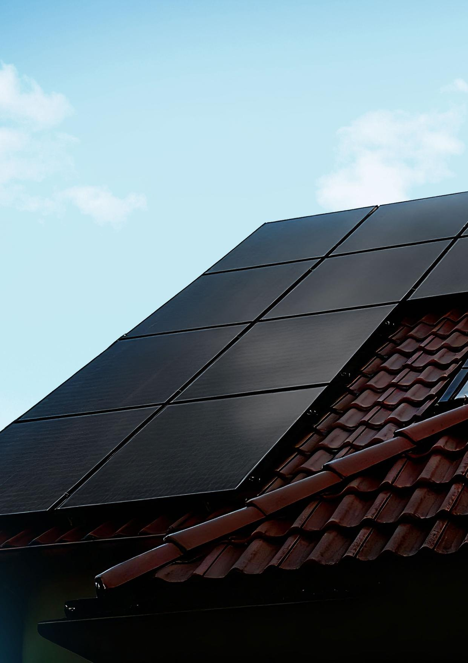
Understand Your Solar Savings How solar works, what affects savings, and why results can differ.

Slide 7
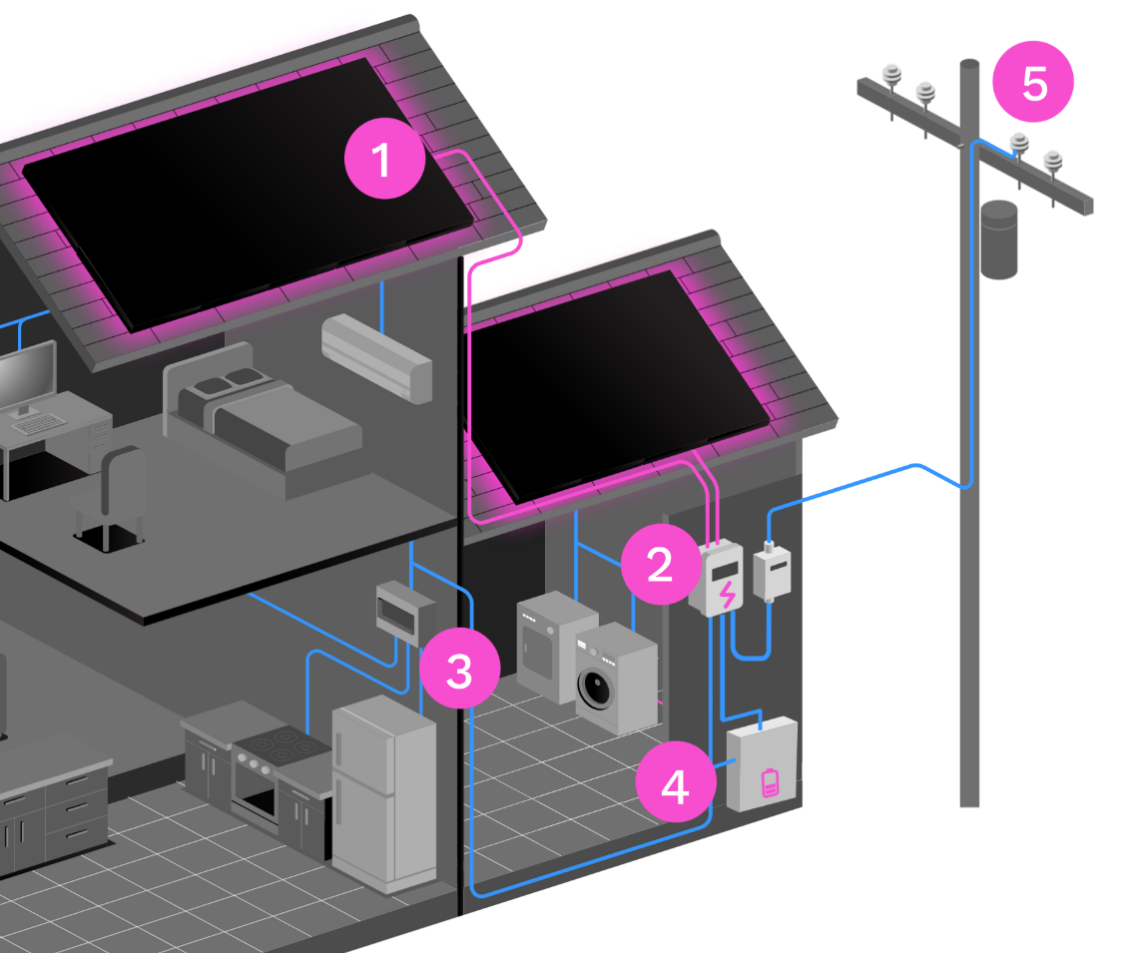
Solar in Action
A simple look at how your solar system works.
Solar Panels | Inverter | Home DB | Battery (Optional) | Power Grid
Capture sunlight and convert it into Direct Current (DC). | Converts DC into usable electricity (AC) for your home. | Distributes solar (when available) and TNB power. | Stores excess Solar Electricity for night use. | Exports leftover solar and supplies power when needed.
1
2
3
4
5
www.emitsolar.com

Slide 8



Maximise Your Solar Savings
Use more Solar Electricity during the day to reduce grid imports and maximise savings.
Solar Electricity Generation
Based on system size; influenced by factors such as roof design, tilt and orientation.
1. Daytime Use
2. Export to Grid
Solar Electricity powers your home as it’s generated
Avoids importing electricity from TNB
Delivers the highest savings
Unused Solar Electricity is sent to the grid
Offsets the Energy charge on your TNB bill
Savings
RM0.49–RM0.60/kWh
Offsets Energy, Capacity, Network, SST & KWTBB charges
Savings
RM0.27–RM0.37/kWh
Offsets Energy charge only
How to Increase Your Savings
Use More Solar During The Day
Run appliances (e.g. washing machine) during solar generation hours (8am-6pm)
Charge your EV when the sun is shining
Schedule high-usage activities for daytime
Consider TNB’s ToU Tariff
May improve savings for homes with flexible usage patterns
Exported Solar Electricity may offset higher-priced peak charges first
www.emitsolar.com

Slide 9
Savings Across Different Usage Scenarios
Understand how usage patterns can impact estimated solar savings.
The tables below illustrates estimated solar savings from a system under different TNB bill and Daytime Electricity Use scenarios. Variations in savings are primarily driven by two factors: How TNB calculates your electricity bill The Solar ATAP mechanism, which affects how excess Solar Electricity exports are valued
Different TNB Bill Before Solar
TNB Bill Before Solar | Daytime Electricity Use | TNB Bill After Solar (+/-) | Solar Savings (+/-) | Payback (+/-)
[ ] | [ ] |  | [ ]
[ ] | [ ] |  | [ ]
[ ] | [ ] |  | [ ]
[ ] | [ ] |  | [ ]
[ ] | [ ] |  | [ ]
Different Daytime Electricity Use %
TNB Bill Before Solar | Daytime Electricity Use | TNB Bill After Solar (+/-) | Solar Savings (+/-) | Payback (+/-)
[ ] | [ ] |  | [ ]
[ ] | [ ] |  | [ ]
[ ] | [ ] |  | [ ]
[ ] | [ ] |  | [ ]
[ ] | [ ] |  | [ ]
16.32kWp
RM1,400
40%
RM487
RM913
3.3 Years
2,372 kWh
948 kWh
65%
RM1,450
40%
RM520
RM929
3.2 Years
2,456 kWh
982 kWh
64%
RM1,500
40%
RM651
RM849
3.5 Years
2,540 kWh
1,016 kWh
57%
RM1,550
40%
RM700
RM849
3.5 Years
2,623 kWh
1,016 kWh
55%
RM1,600
40%
RM750
RM849
3.5 Years
2,707 kWh
1,016 kWh
53%
RM1,500
30%
RM708
RM792
3.7 Years
2,540kWh
762 kWh
53%
RM1,500
35%
RM679
RM821
3.6 Years
2,540kWh
889 kWh
55%
RM1,500
40%
RM651
RM849
3.5 Years
2,540kWh
1,016 kWh
57%
RM1,500
45%
RM526
RM973
3.0 Years
2,540kWh
1,143 kWh
65%
RM1,500
50%
RM499
RM1,001
3.0 Years
2,540kWh
1,270 kWh
67%
(+/–) All figures are estimates and are based on current tariff and Solar ATAP policy.
TNB bill calculations use the general (non-ToU) tariff and exclude the Automatic Fuel Adjustment (AFA), which changes monthly and may be a charge or rebate.
www.emitsolar.com

Slide 10
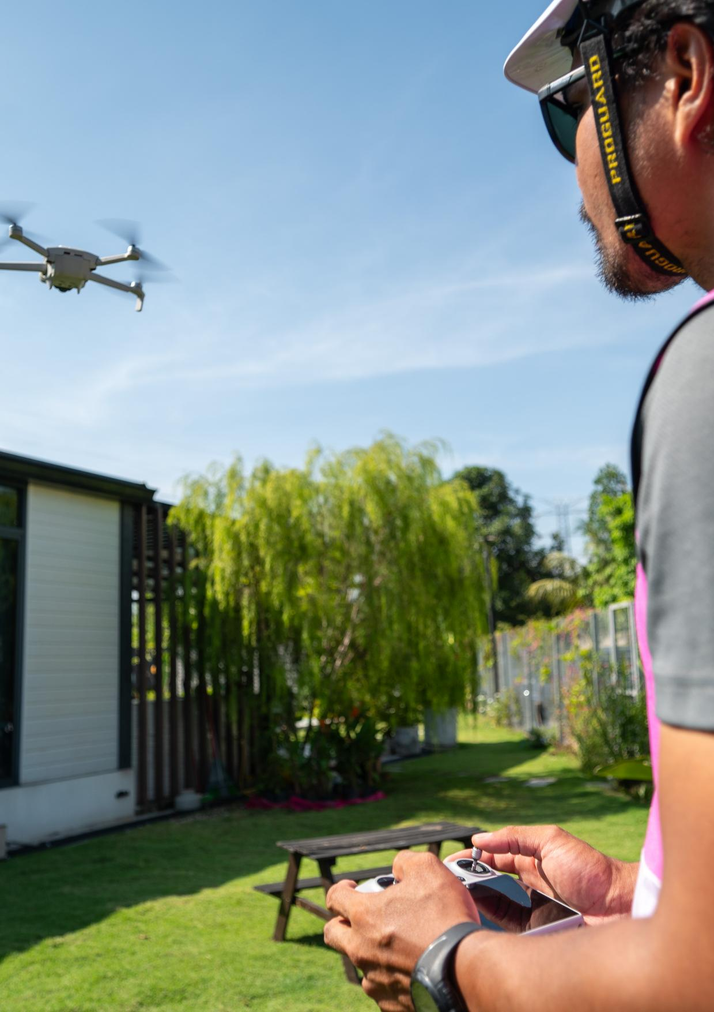
Review Your Installation Plan From panel layout to equipment placement, planned specifically for your home.

Slide 11

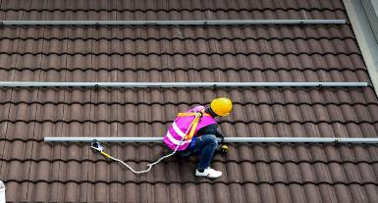
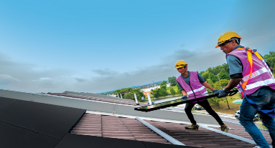

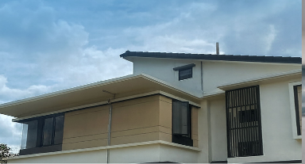
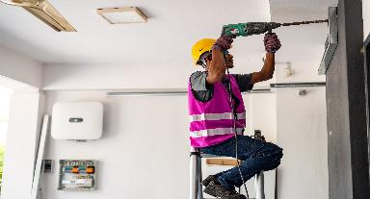
Standard Installation Process
1
Solar Rail Hooks
Installed on key rafters to anchor the solar rails.
2
Solar Rails
Mounted onto the hooks to support the solar panels.
3
Solar Panels – Laying the Panels
Secured onto the rails according to the approved layout.
4
Solar Panels – Connecting the Panels
Electrically connected (stringed) to allow Solar Electricity to flow from the panels to the inverter.
5
Cable Routing – GI Trunking
DC cables are routed from the roof to the inverter using galvanised iron (GI) trunking for protection, durability, and a neat finish.
6
Inverter & PVDB
The inverter and PV Distribution Board (PVDB) are installed and connected to your home’s Distribution Board (DB).
All installations are carried out by certified installers and comply with applicable electrical and safety standards.
Actual methods and sequencing may vary depending on roof type, structure, and site conditions.
www.emitsolar.com

Slide 12
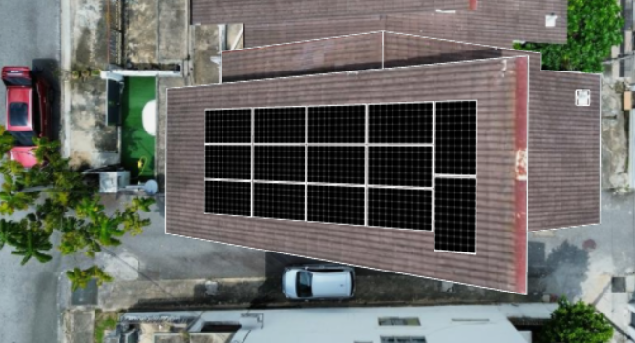
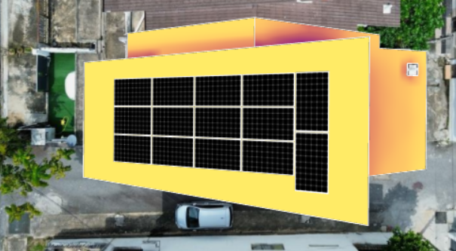
Solar Panel Layout
The layout of solar panels on your rooftop is designed to maximise sun absorption, Solar Electricity generation, and your savings.
Grey rectangles indicate additional panel placement if you choose to maximise your roof space.
Ideal panel positioning for maximum sunlight exposure.
www.emitsolar.com

Slide 13
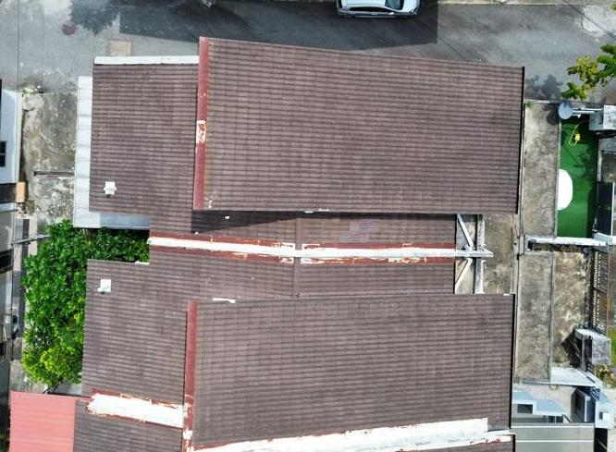
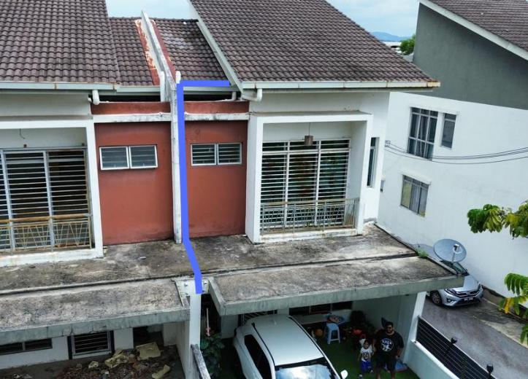
DC (Rooftop) Cable Routing
The DC cable runs from the panels to the drop point, indicated by the blue circle.
It is routed to the porch via the drop point, concealed under the roof tiles.
www.emitsolar.com

Slide 14
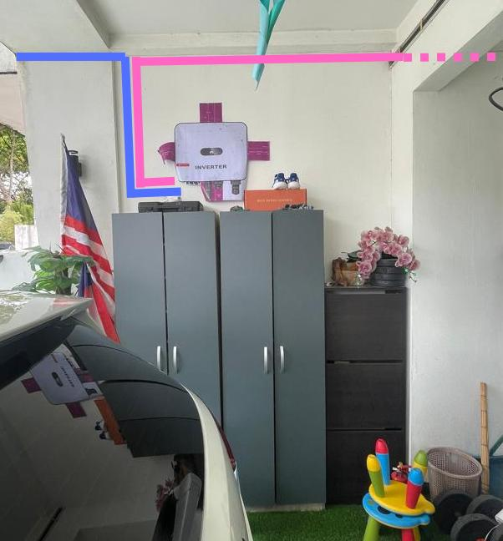
Inverter & PVDB Location
A ceiling opening will be made for the DC cable to come down from the rooftop, and for routing the AC cable from the PVDB to the home’s distribution box (DB).
The AC cable will pass through the porch to the DB.
DC Cable
AC Cable
Concealed Portion
We recommend placing these components outside your home in a well-ventilated area, shaded and protected from the weather for several reasons:
Heat Dissipation | Open spaces keep your inverter cooler for better performance and longer life.
Accessibility | Easier maintenance without disrupting the household.
Future-Proof | Easily integrate an EV charger or batteries in the future.
www.emitsolar.com

Slide 15
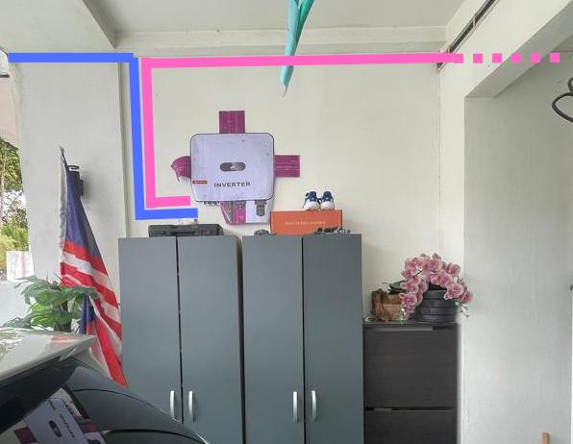
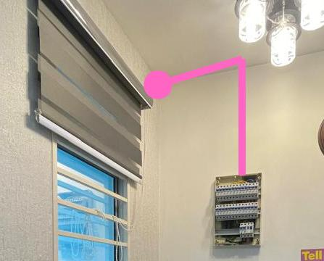
AC Cable Routing
AC cables are routed from the PVDB to the home’s DB, concealed within the plaster ceiling of the porch.
A small ceiling opening will be made above the DB for AC cables to come down from ceiling and connect to the DB at the living hall.
www.emitsolar.com

Slide 16
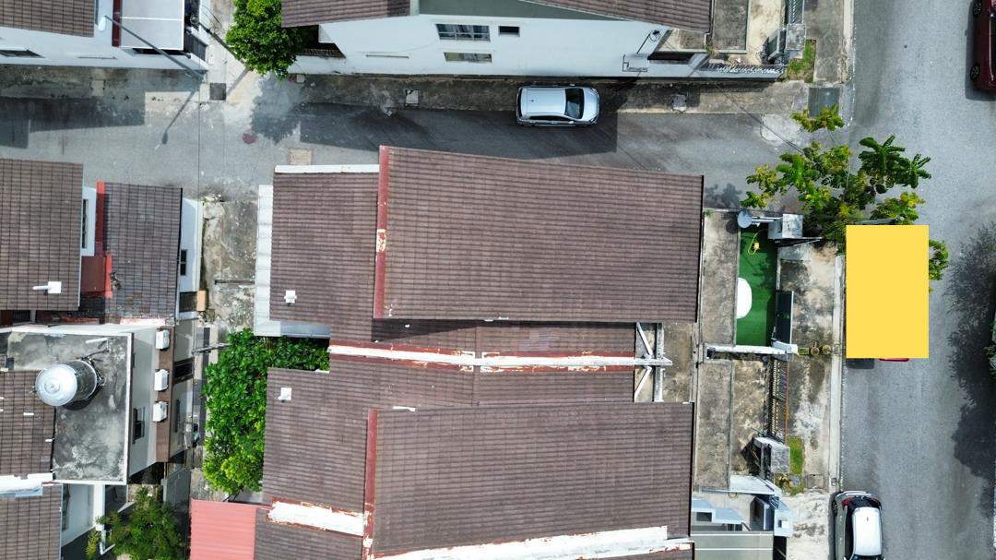
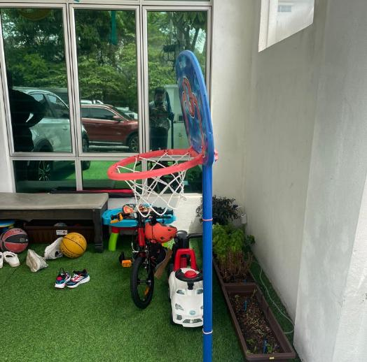
Work Area
The area highlighted is designated for the skylift.
The solar system materials will be placed at the location marked below during installation.
www.emitsolar.com

Slide 17
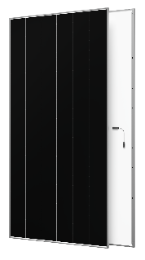
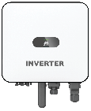

System Components
High-Performance Solar Panels
Aiko COMET 3N72 [Product Specs]
Latest N-Type ABC Panels
24.8% efficiency
Highest yield per sq. feet
Panels​
32
Hybrid Inverter
Huawei SUN 2000 [Product Specs]
High Efficiency
Smart AI Monitoring & Diagnostics
Phase Allocation Optimisation
EV & Dynamic Load Charging Capability
1 Unit
Other Components
Certified AC, DC and Earth cables
Panel Mounting Rails & Brackets
MC4, Cable Crimping, & Cable Trunking
1 Set
www.emitsolar.com

Slide 18
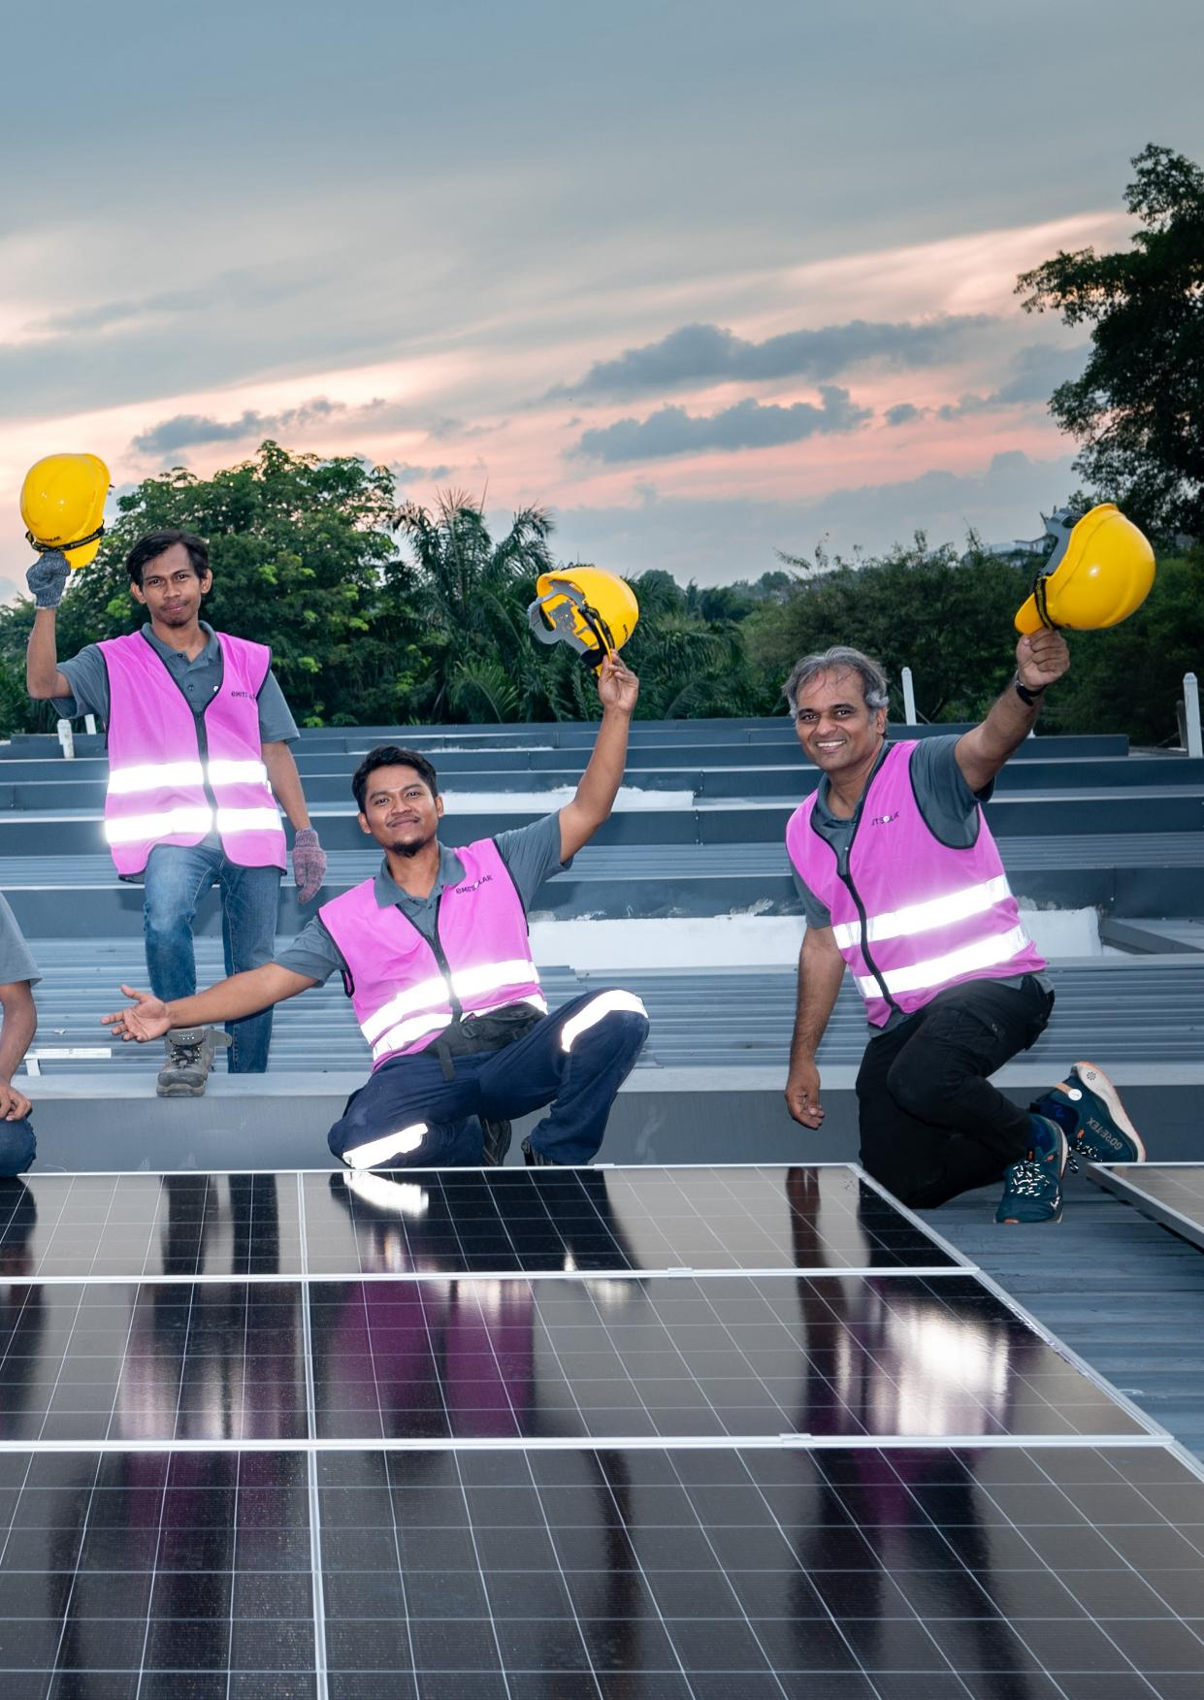
See Why Homeowners Choose Emit Solar Comprehensive protection, ongoing support, flexible upgrades, and proven customer trust.

Slide 19
Beyond Manufacturer Warranties
Manufacturers protect components. Emit Solar protects the entire system.
Coverage Area | Manufacturer | Emit Solar
What’s Covered | Components | Complete System & Workmanship
Installation Workmanship
System-Level Issues
Labour & Transport
Warranty Claim & Handling
Monitoring & Support
X
√
X
√
X
√
X
√
X
√
Manufacturer Warranties
Solar Panels
Product Warranty: 15 Years
Performance Warranty: 30 Years
Inverter
Product Warranty: 10 Years
Product Warranties cover product defect while the Performance Warranty cover panel output over the long term.
Emit Solar Warranties
Installation Warranty
1 Year
Covers workmanship defects during installation
System Warranty
2 Years
Ensures the system works as installed
Includes the repair and replacement of system components + labour and transportation
Extended Support Package (Emit EzSolar)
Up to 10 Years (contract duration)
Support for system faults caused by faulty components
Includes labour for replacing faulty components covered by manufacturer warranty
Emit Solar Warranties commence from activation date. Terms & Conditions apply.
www.emitsolar.com

Slide 20
Ongoing Care, Even After Warranties End
Optional health checks to keep your solar system safe and efficient.
What’s Included | Standard RM300/visit (RM450 after hours) | Comprehensive RM650/visit
Visual inspection of inverter, PVDB and wiring
Electrical checks and connection testing (on-ground)
Check safety components are working properly​
Review inverter alarm logs
Basic troubleshooting (reset, reconfigure, small fixes)​
System performance report
Visual inspection of panels, conduits and connectors
Infrared thermal scan of panels
Ensure mounting structures are secure and intact
Ensure rooftop cables are properly insulated and secure​
Run earth loop test for compliance
Clean all the panels
√
√
√
√
√
√
√
√
√
√
√
√
√
√
√
√
√
√
1. Corrective works (e.g. replacing faulty parts) quoted separately and may require a return visit
2. Excludes out-of-warranty parts & materials, corrective works, roof-level works
3. If required, skylift charges range from RM500 to RM750, depending on roof height and accessibility
4. Prices are subject to change over time and are subject to SST
www.emitsolar.com

Slide 21
Future-Proof Add-Ons
Designed to grow with your energy needs, lifestyle and future upgrades.
Prices valid until 15 June 2026, subject to change. Final pricing will be confirmed upon request.
Smart Energy Storage System Huawei LUNA2000 [Product Specs]
Option | What’s Included | Price
7kWh | 1x battery module + BESS controller | RM20,000
14kWh | 2x battery modules + BESS controller | RM34,800
21kWh | 3x battery modules + BESS controller | RM49,600
Installation | Setting up of battery module(s) | RM750 (waived if installed within 12 months of your system)
Higher capacity provides more stored Solar Electricity and supports greater nighttime usage. Actual savings depend on household usage patterns.
Optional Battery Add-On
Add-On | What’s Included | Price
Backup Power Box | Interface to power essential appliances during blackouts | RM2,800 (1‑phase) RM4,300 (3‑phase)
Emit Digital Energy Hub Engineered by Emit Solar
Option | What’s Included | Price
EV-Ready DB¹ | Energy Hub + EV charging safety components and isolator | RM2,000
Optional EV Charging Add-Ons
Add-On | What’s Included | Price
EV Charger Expansion² | Cables and connections from the isolator to your own EV charger | RM600
Complete EV Expansion² | Full setup, including the supply and install of a Huawei EV charger | RM3,500 (1-phase) RM3,900 (3-phase) - Subject to availability -
¹ Uses different wiring and must be confirmed in your order to be installed together with your system. ² includes up to 5-metre wiring between Energy Hub and EV charger; additional length RM50/metre.
www.emitsolar.com
Prices may be subject to SST where applicable.

Slide 22
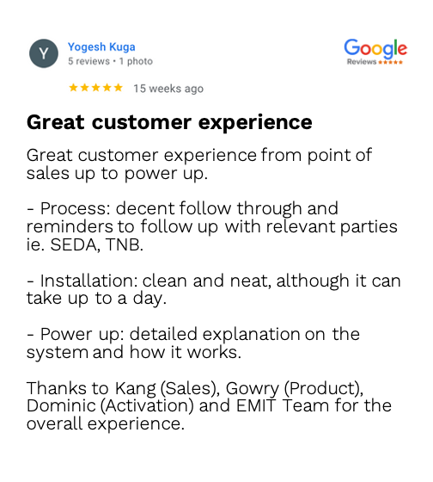
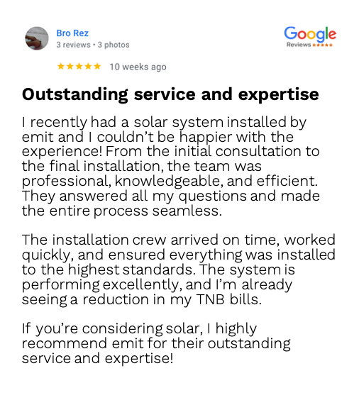
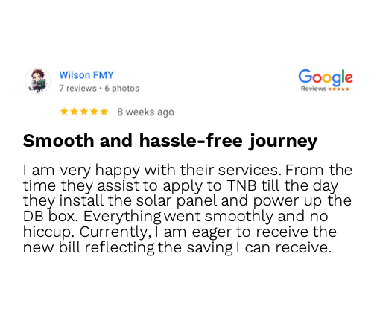
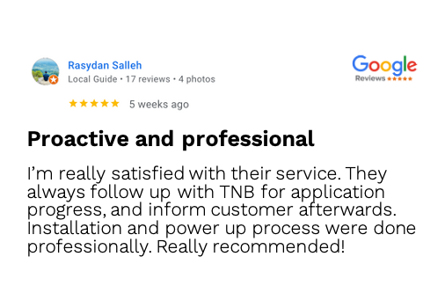
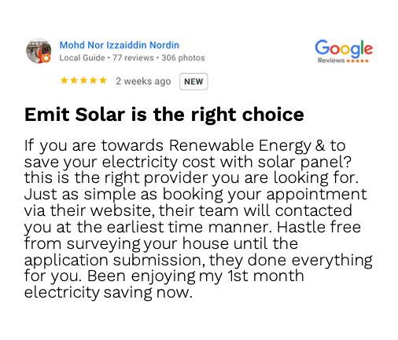
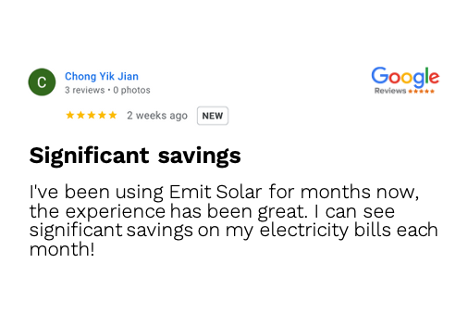
Trusted by Homeowners
Real customers, real experiences.
www.emitsolar.com

Slide 23

Your Solar Journey, Made Simple
We’re with you every step of the way.
1
Home Visit & ATAP Eligibility Check
We assess your home’s solar potential, request a few documents for ATAP eligibility confirmation, and prepare your solar proposal.
2
Proposal Acceptance
Once you’re satisfied, accept our proposal, and we’ll submit your ATAP application.
3
Installation
Our team carries out a safe and smooth installation, setting you up for long-term savings.
4
Activation
After TNB upgrades your account and if applicable your meter, we will activate the system.
5
Everyday Savings
Enjoy worry-free savings, with ongoing support whenever you need us.
www.emitsolar.com

Slide 24



Solar Made Simple
emitsolar.com

